Slide 1
Intermolecular Bonds
Jason R Mayberry, PhD

Slide 2
Types of Chemical Bonds
Intra-Molecular Bonds (Inside the molecule) : Bonds between atoms which are strong enough to form molecules (Ionic or Covalent)
Inter-Molecular Bonds:
  Attractive forces between molecules which are not strong enough to form new molecules.
  Types of Inter-Molecular Bonds
    Hydrogen Bonds: Attraction between Polar Molecules
    Van Der Waals (London) Forces: Attraction between non-Polar Molecules
8
Molecular Bonds
1
1
Atoms
Molecule
δ –
δ+
δ –
Inter-Molecular Bond
δ+
δ –
δ+
δ+
δ+
δ+

Slide 3
Hydrogen Bonds
δ –
Inter-Molecular attraction between:
  A Hydrogen atom which has a partial “+” charge (as in a polar covalent bond)
  An atom which has a negative charge or an unbound pair of electrons
Important biological instances with H that will form Hydrogen bonds.
  …O–H^{δ+}
  …N–H^{δ+}
Biologically Important in:
  Water: Lots of unique properties
  DNA: Keeps two strands together
  tRNA: Folding back on itself
  Proteins: Involved in folding and stability
δ+
δ+
δ –
Hydrogen Bonds
δ –
δ+
δ+
δ+
δ+
δ –
δ+
δ+

Slide 4
Common Hydrogen Bonds
Hydrogen bonds often form between partially charged H atoms (i.e. O – H and N – H , and lone pairs of electrons not participating in bonds.
H
H
O
H
O
H
O
H
H
N
C
C
OH
Hydrogen Bond
H
O
Hydrogen Bond
H
R
H
H
H
O
N
C
C
OH
H
R

Slide 5
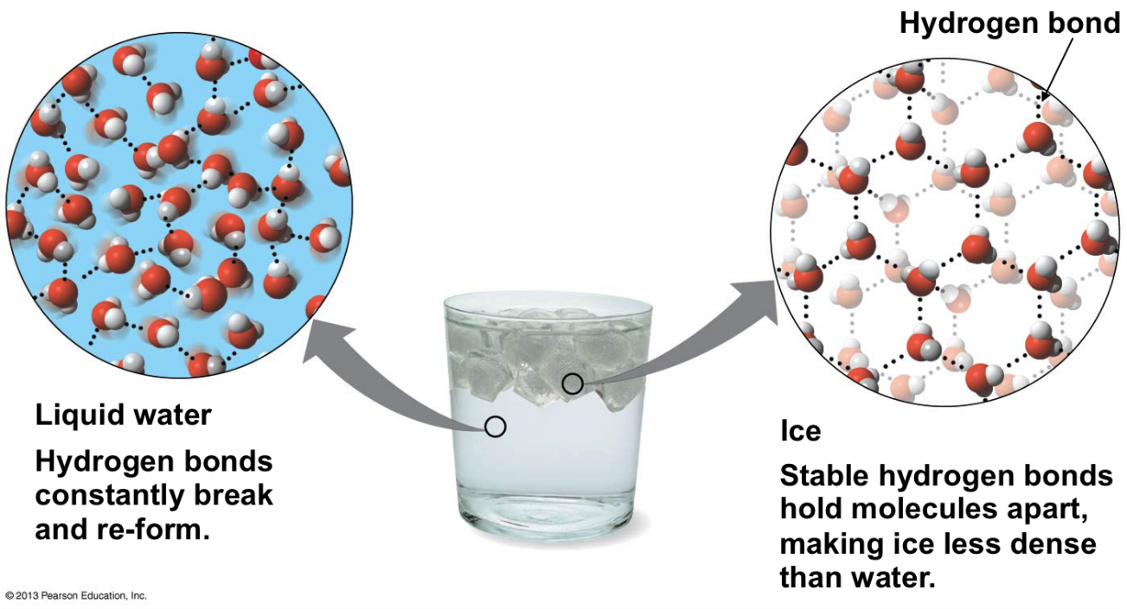
Hydrogen Bonds
Hydrogen Bond: weak bond between molecules due to the attraction of constituent atoms with opposite partial charges.
Most Common Example: Water
H
O
H
O
H
H
H
O
Hydrogen Bond
H
Any two molecules with opposite partial charges can experience hydrogen bonds.
δ+
δ–
OH
N
H2
Hydrogen Bond

Slide 6
Continuum of Bonding Types
Intra-molecular
Inter-molecular
Non-Polar Covalent
Polar Covalent Bonds
Ionic Bonds
Hydrogen Bond
Partial Charges
50/50 Sharing
75/25 Unequal Sharing
100/0 No Sharing
Methane
Water
Sodium Chloride
H
O
H
O
H
δ–
Na⁺Cl–
H
H
δ+
H
O
δ+
H
O
H
C
H
H
H
H
–
Na⁺
Cl–
H
O
O
+
δ+
+
H
Sodium Ion
Chloride Ion
H
O
H
H
Hydroxide Ion
Hydrogen Ion
H
H
O
H

Slide 7
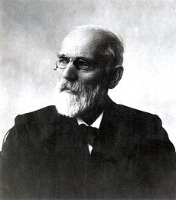
Van der Waals (London) Forces
Inter-molecular Attraction between Non-Polar Molecules
Electron cloud around atoms wobbles slightly
Wobble produces a temporary dipole
This dipole can induce a dipole around neighboring atoms
Attraction between the temporary dipoles causes a weak temporary attraction known as Van Der Waals Attraction
Biologically Important in:
Cell membranes
Protein folding
Ligand-Receptor
Gecko feet pads
Johannes van der Waals
1
δ δ +
1
6
1
1
6
1
1
1
δ δ –
1
Methane
No Attraction when distant
Very Weak attraction when close
H
H
C
H
H
H
H
H
C
H
H
C
H
H
C
H
H
C
H
H
C
H
H
C
H
H
C
H
H
C
H
H
C
H
H
C
H
H
C
H
H
C
H
H
H
C
H
H
C
H
H
C
H
H
H
H

Slide 8
Continuum of Bonding Types
Intra-molecular
Inter-molecular
Non-Polar Covalent
Polar Covalent Bonds
Ionic Bonds
Hydrogen Bond
Van der Waals
Between Partially Charged groups
Between non-Polar groups (induced dipoles)
50/50
75/25
100/0
Methane
Water
Sodium Chloride
H
O
H
O
H
δ–
Na⁺Cl–
H
H
C
H
H
C
δ+
H
O
δ+
H
O
H
C
H
C
H
H
C
H
H
H
–
Na⁺
Cl–
H
O
O
+
δ+
+
H
Sodium Ion
Chloride Ion
H
O
H
C
H
H
Hydroxide Ion
Hydrogen Ion
H
C
H
H
C
H
O
C
H
H

Slide 9
Continuum of Bonding Types
Intra-molecular
Inter-molecular
Non-Polar Covalent
Polar Covalent Bonds
Ionic Bonds
Hydrogen Bond
Van der Waals
Between Partially Charged groups
Between non-Polar groups (induced dipoles)
50/50
75/25
100/0
Methane
Water
Sodium Chloride
H
O
H
O
H
δ–
Na⁺Cl–
H
H
C
H
H
C
δ+
H
O
δ+
H
O
H
C
H
C
H
H
C
H
H
H
–
Na⁺
Cl–
H
O
O
+
δ+
+
H
Sodium Ion
Chloride Ion
H
O
H
C
H
H
Hydroxide Ion
Hydrogen Ion
H
C
H
H
C
H
O
C
H
H

